Slide 1
Cookies
Sessions
Tokens

Slide 2
Cookie ?
Cookies are data, stored in small text files, on your computer.
name = value pairs
Bits of data that are sent back and forth between client and server
Used to keep track of
State of an application,
Session information
Visit of user ID etc.

Slide 3
Web Cookies (or HTTP Cookies)
Browsers allow the storage of limited data on the client machine
Can be created by the server
Or by a client-side scripts
Cookies were invented to solve the problem "how to remember information about the user":
When a user visits a web page, his/her name can be stored in a cookie.
Next time the user visits the page, the cookie "remembers" his/her name.

Slide 4
What’s the Need Behind Cookies?
HTTP is a stateless protocol(A stateless protocol is a communication method that treats each message as independent and doesn't rely on previous history. This means that the protocol doesn't require the server to retain information or status about each user for the duration of multiple requests.)
Client requests a page, and server sends it
Client later requests a 2nd page; it is sent
But HTTP doesn’t give a way for the server to know it’s from the same user
Being stateless is simpler for HTTP
But limiting to applications

Slide 5
Cookies in Action
The scenario is:
Browser about to send a request for a URL
But it first looks for cookies linked to that URL that are stored on client machine
If found, the cookie is sent to the server with the HTTP request for the URL
Server uses cookie data
E.g. associate this current visit with a previous visit
Server may then set updated cookie on client machine
E.g. to be sent back with the next request

Slide 6
Purposes of Cookies
Authentication
User-id, password stored on client
Sent on next visit. No login required!
Personalization
Remember user preference for fonts, colors, skin, site-options, etc.
Shopping carts
Tracking
How is our site used?
Multi-site tracking by companies looking for usage profiles etc.

Slide 7
Cookie FAQs and Myths
They don’t transmit viruses.
Can’t erase data on client machine.
Can’t read personal info on client machine.
Not used for spamming, pop-ups.
Are they spyware?
Notes:
Profiles of page usage
Anonymous unless info provided by user.
Still…
How do companies use cookies to develop a user-profile? Is this “wrong”?

Slide 8
Is it a Spyware?
Cookies themselves are not spyware. However, they can be misused for tracking and privacy-invading purposes, which is why they are sometimes associated with privacy concerns.
Cookies are small pieces of data that websites store on a user's device (typically in the user's browser) to track information related to their browsing session. These cookies can serve legitimate purposes, such as keeping a user logged in, remembering user preferences, and helping websites provide a better user experience.

Slide 9
However, some cookies, often referred to as "third-party cookies," can be used by advertising networks and analytics services to track a user's online behavior across different websites. This tracking can be used to build user profiles and deliver targeted advertising. When used without the user's knowledge or consent, this can be seen as an invasion of privacy and can raise concerns.
To address these privacy concerns, modern web browsers have introduced features that allow users to block or limit third-party cookies, provide notifications about cookie usage, and implement stronger privacy controls. Additionally, regulations like the General Data Protection Regulation (GDPR) and the California Consumer Privacy Act (CCPA) have imposed restrictions on how websites can use cookies and require them to obtain user consent.

Slide 10
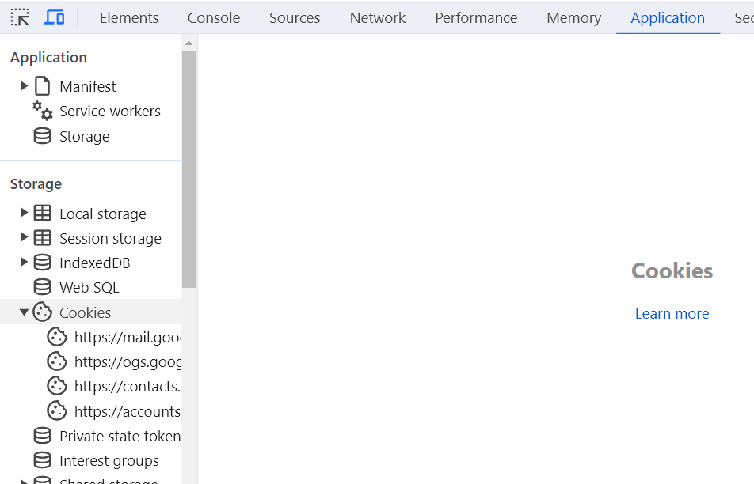
Inspect in browser

Slide 11
What’s in a Cookie?
It’s just text data as follows:
NAME=VALUE
Name value pairs
expires=<date> (optional)
Without a date, deleted when browser closed
path=<path> (optional)
domain=<domain> (optional)
secure (optional)

Slide 12
Browser Control of Cookies
At least 20 cookies per domain
Newer browsers store more
But most sites use just one, and have an ID value to reference info stored on server
Total size limit on all cookies (e.g. 4K )

Slide 13
Browser Control of Cookies (2)
User can control how they’re handled:
Don’t let the server write them to client PC
Asks permission (perhaps with a white-list)
Always accept them
Perhaps except for those on a black-list
User can view and manage cookies
E.g. Firefox’s Preferences->Privacy->Show Cookies
E.g Chrome -> Inspect-> Application-> Storage-> Cookies

Slide 14
Try This
In your browser’s address field, type:
javascript:alert("Cookies: "+document.cookie)
Note javascript: pseudo protocol - to run the javascript code followed by it.
You know alert in JavaScript now

Slide 15
Again, How Do I Write a cookie in scripts?
Clearly important for server-side scripts
Server sends an HTTP message to the client
Scripting languages simplify this
E.g. PHP: setcookie(‘name’, ‘value’,…);
More on this later
Server-side scripting and Session IDs

Slide 16
Javascript cookies on client machine
<!DOCTYPE html>
<html>
<head>
<title>Cookie Example</title>
</head>
<body>
<h2>Cookie Demo</h2>
<button onclick="testCookies()">Test Cookies</button>
<script>
function testCookies() {
document.cookie = "user=priya; path=/";
document.cookie = "firstName=amrita; expires=Fri, 19 Aug 2025 12:22:00 UTC; path=/";
console.log("Current cookies: " + document.cookie);
console.log(navigator.cookieEnabled);
}
</script>
</body>
</html>

Slide 17
JavaScript on the Client-Side
To Create Cookie
document.cookie=“user=tom;domain=cs.uva.edu;path=/cs453; secure;”
document.cookie=“firstName=XYZ, expires= .. Path…
console.log(document.cookie)

Slide 18
To check whether the cookie is enabled
console.log(navigator.cookieEnabled) - check in console(inspect page)

Slide 19
Attributes of Cookies in JS
JavaScript supports the following main cookie attributes:
Name and value (required)
expires
max-age
path
domain

Slide 20
Name and Value
name=value
name – an identifier for the cookie,
value - data you want to store.
These are typically provided together when creating a cookie.
E.g. document.cookie=“firstName=XYZ”

Slide 21
Expires attribute
Cookies expire after a certain amount of time; however, the cookie’s expiration settings can be handled through its offered “expires” attribute in JavaScript.
Cookies are automatically removed when the browser is closed. It prohibits the visitors from reusing the cookie’s values when they later visit the website. However, this behavior can be controlled by setting the “expiration date” for the cookie.
Cookies in JavaScript offer an “expires” attribute that permits you to add an “expirationDate” in Universal Time Coordinated (UTC) to the “name=value” cookie pair.

Slide 22
Syntax
document.cookie = "name=value; expires=expirationDate UTC“
Eg:
document.cookie = "username=XYZ;expires=Sun, 10 Aug 2030 12:00:00 UTC";
if the cookie gets expired or deleted, the alert box will state that “Cookie not available”:

Slide 23
Max-Age(Optional)
max-age = seconds:
Specifies the maximum age of the cookie in seconds.
This takes precedence over the expires attribute.
If both max-age and expires are set, max-age is used.

Slide 24
Domain (Optional):
domain=domainname:
Limits the cookie's scope to a specific domain and its subdomains.
By default, cookies are only available to the domain that set them.
E.g. domain=example.com

Slide 25
Path(Optional)
path=path:
Restricts the cookie's availability to a specific path on the website.
By default, cookies are available to the path that set them.
E.g. path=/
it means that the cookie is available to all pages on the website hosted on the current domain.
In other words, the cookie is accessible to any page under the root directory of the website.
E.g. document.cookie = "myCookie=myValue; path=/subfolder";

Slide 26
Secure(Optional)
If present, the cookie will only be sent over secure (HTTPS) connections.
It helps protect sensitive data in the cookie.

Slide 27
HttpOnly (Optional):
If present, the cookie cannot be accessed via JavaScript.
This attribute is often used to enhance security by preventing access to cookies from client-side scripts.

Slide 28
Sessions ?
Sessions are a server-side mechanism for maintaining stateful information about a user's interactions with a web application.
When a user logs in, the server creates a session and assigns a unique session identifier (usually stored in a cookie). This identifier is used to associate subsequent requests from the same user with their session data on the server.
Session data is typically stored on the server. It can include user-specific information, such as login status, shopping cart contents, and preferences.
Sessions are generally considered more secure than storing sensitive information in client-side cookies because the data resides on the server.

Slide 29
Tokens ?
Tokens, often referred to as authentication tokens or access tokens, are used for user authentication and authorization in web applications and APIs.
When a user logs in, the server generates a token and provides it to the client (typically through a secure process). The client includes this token with each subsequent request to access protected resources.
Tokens can be stored in various ways, including cookies, local storage, or as part of the request headers.
Tokens are a popular choice for securing API endpoints and ensuring that only authenticated users can access protected resources. They are often time-limited and can be invalidated or refreshed.

Slide 30
Summary
Cookies are small pieces of data stored on the client's device and can serve various purposes, including session management and storing user preferences.
Sessions are server-side mechanisms for managing stateful data about a user's interaction with a web application.
Tokens are typically used for authentication and authorization, allowing clients to access protected resources.
The choice between sessions, tokens, and cookies depends on the specific use case and requirements of a web application. They can also be used in combination to provide a comprehensive solution for user management, security, and state management.

Slide 31
Add cookies to signup page to store the username and password in cookies. When you press submit button, the alert should greet you as" Congratulations + your username!!!! + U have successfully registered" (Use stored cookie value) for eg. Congraluations Priya!!!! U have successfully registered - in the alert box.

Slide 32
SameSite (Optional):
samesite=strict or samesite=lax or samesite=none:
This attribute controls when cookies should be sent in cross-origin requests.
It helps mitigate certain types of attacks.
The values strict and lax enforce different degrees of same-site behavior, while none allows cookies to be sent in cross-origin requests.

Slide 33
Inspect Element for Penetration Testing

